Slide 1
ASSIGNMENT 1
BEER FROTH COMPARISON USING CURVE FITTING
SARAL JOSHI

Slide 2
AGENDA
PROBLEM DISCUSSION
DISCOUNTING LINEAR MODEL FOR THIS DATA
COMPARING NON-LINEAR MODELS
CHOOSING A MODEL
DETERMINING BEST BEER

Slide 3
PROBLEM DISCUSSION
Given data has decay of froth over time for three beers. It is assumed the beers are in
glasses of same size and shape
poured under similar conditions and
there are no errors in measurement.
Nature of decay of beer froth over time will determine which beer is the best.
The approach was to fit various regression models to the data, analyze the fit while accounting for complexity of the model (degrees of freedom) and studying residues to ensure accuracy of the model for prediction. Alt: Using first differential to fit a curve was discussed, but dropped because it would have to be integrated anyway to get the y-intercept at end point of the mode.

Slide 4
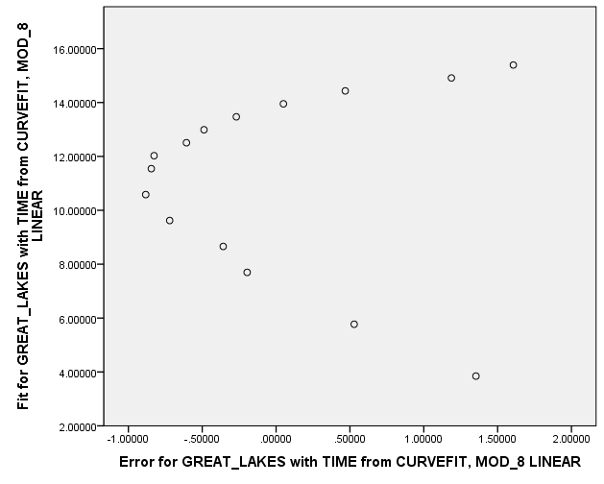
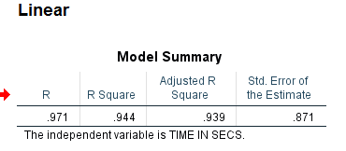
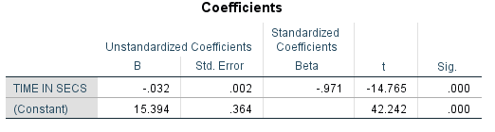
FITTING A LINEAR MODEL TO THE FIRST BEER
It is necessary to first establish that we really do need a non-linear model for our data. Hence a linear model was run on the first beer, GREAT LAKES. A very high R-Square value was obtained. However the residue vs fitted plot shows a pattern (see below). This pattern normally indicates that the regression equation is missing a higher order term. Hence, We cannot use linear regression to predict froth with time.
Y – Predicted, X- Residues, Linear Model

Slide 5
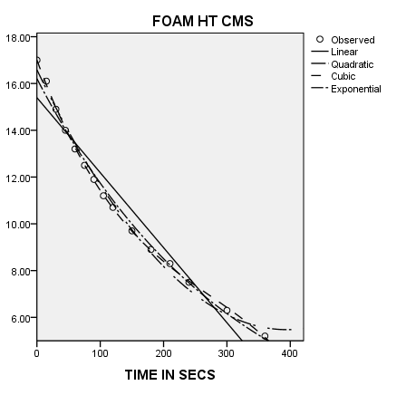
COMPARING NON LINEAR MODELS
Figure to the right is curve fit graph for GREAT LAKES, which shows us which of the models are closest to the actual data.
Cubic model is the closest to actual, it also has the highest R-Squared value. However, the model is complex, having the lowest degrees of freedom. The results of cubic model need to be punished for higher complexity, chi square goodness of fit test is a good measure to account for the difference of degree of freedom when compared against a simpler model, such as exponential in this case. This analysis did not do the goodness of fit, however, the difference in R-square is so small 0.005, hence the need to do the test was not felt. Since R squares are so high for all models, we will focus on predictive ability of the models, using residue vs fitted plots.

Slide 6
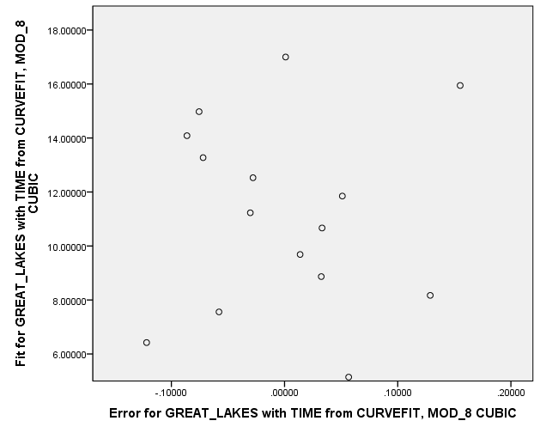
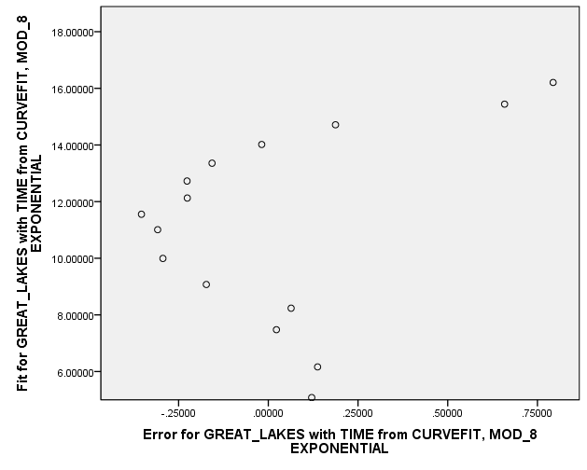
CHOOSING A MODEL
Below figures compare residue-fitted graph between cubic model and exponential model. In the GREAT LAKES case, the exponential model is showing similar nature to linear model, which means a higher order term could be fitted to make the better. A higher order model, i.e. cubic shows randomness in the same plot, which is a good sign, however, the plot is concentrated at some points. Hence the results for cubic aren’t that great either. Similar analysis was performed for quadratic models, however, the ones of most interest are discussed here.

Slide 7
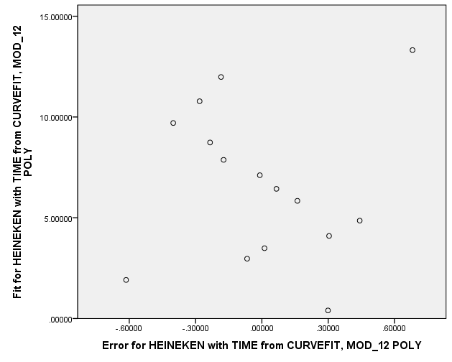
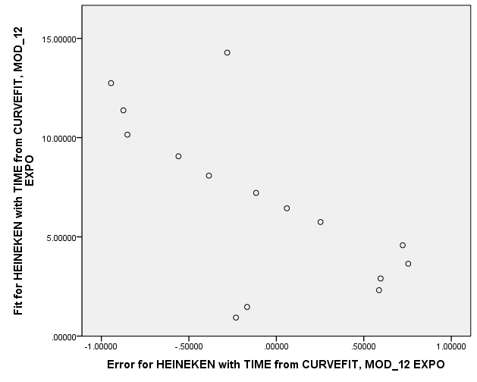
CHOOSING A MODEL
The earlier mentioned analysis were performed with other beers. For Heineken cubic and exponential models are practically the same, giving the same residue plot and similar R-square Values. Hence the simpler model, i.e. exponential will be chosen as final. The results of the curve fitting are given in the attached finalized output.

Slide 8
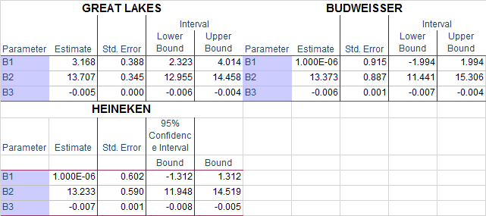
DETERMINING BEST BEER
The equation is similar to diminishing return equation except for negative slope Y= β1+ β2*e^(β3X) , where β3 <0 Initial values for betas were chosen based on the data and then optimized using SPSS, with some constraints (see syntax) The final results are shown below. All results are significant. Great lakes stands out as the best beer with slowest rate of decline B3, and it will always have some froth remaining when other two reach 0 , see B1.

Slide 9
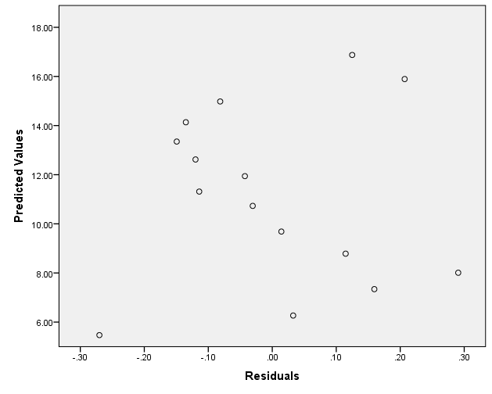
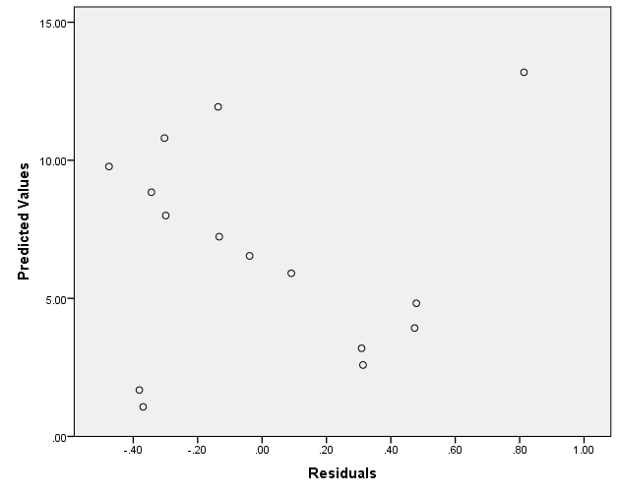
DETERMINING BEST BEER
Below are plots of residual vs fitted for the final model. There is a series of decreasing points in Y for all three. Literature has indicated that this implies there is an outlier in the data. However, there is no use deleting the initial and final point from the data, since we will have to do that again. Overall, all models are a great fit, but their future prediction accuracy is doubtful.
GREAT LAKES
HEINNEKEN
BUDWEISSER

